Slide 1




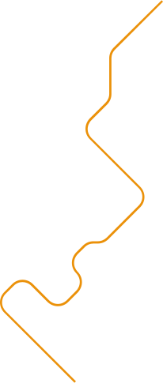

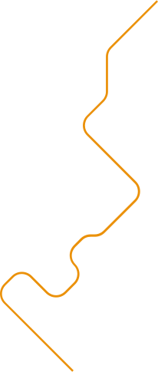

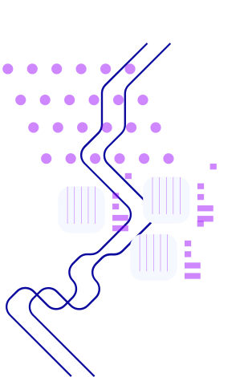
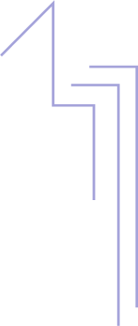


Neural Classifier
NumPy implementation, training, and evaluation

Slide 2

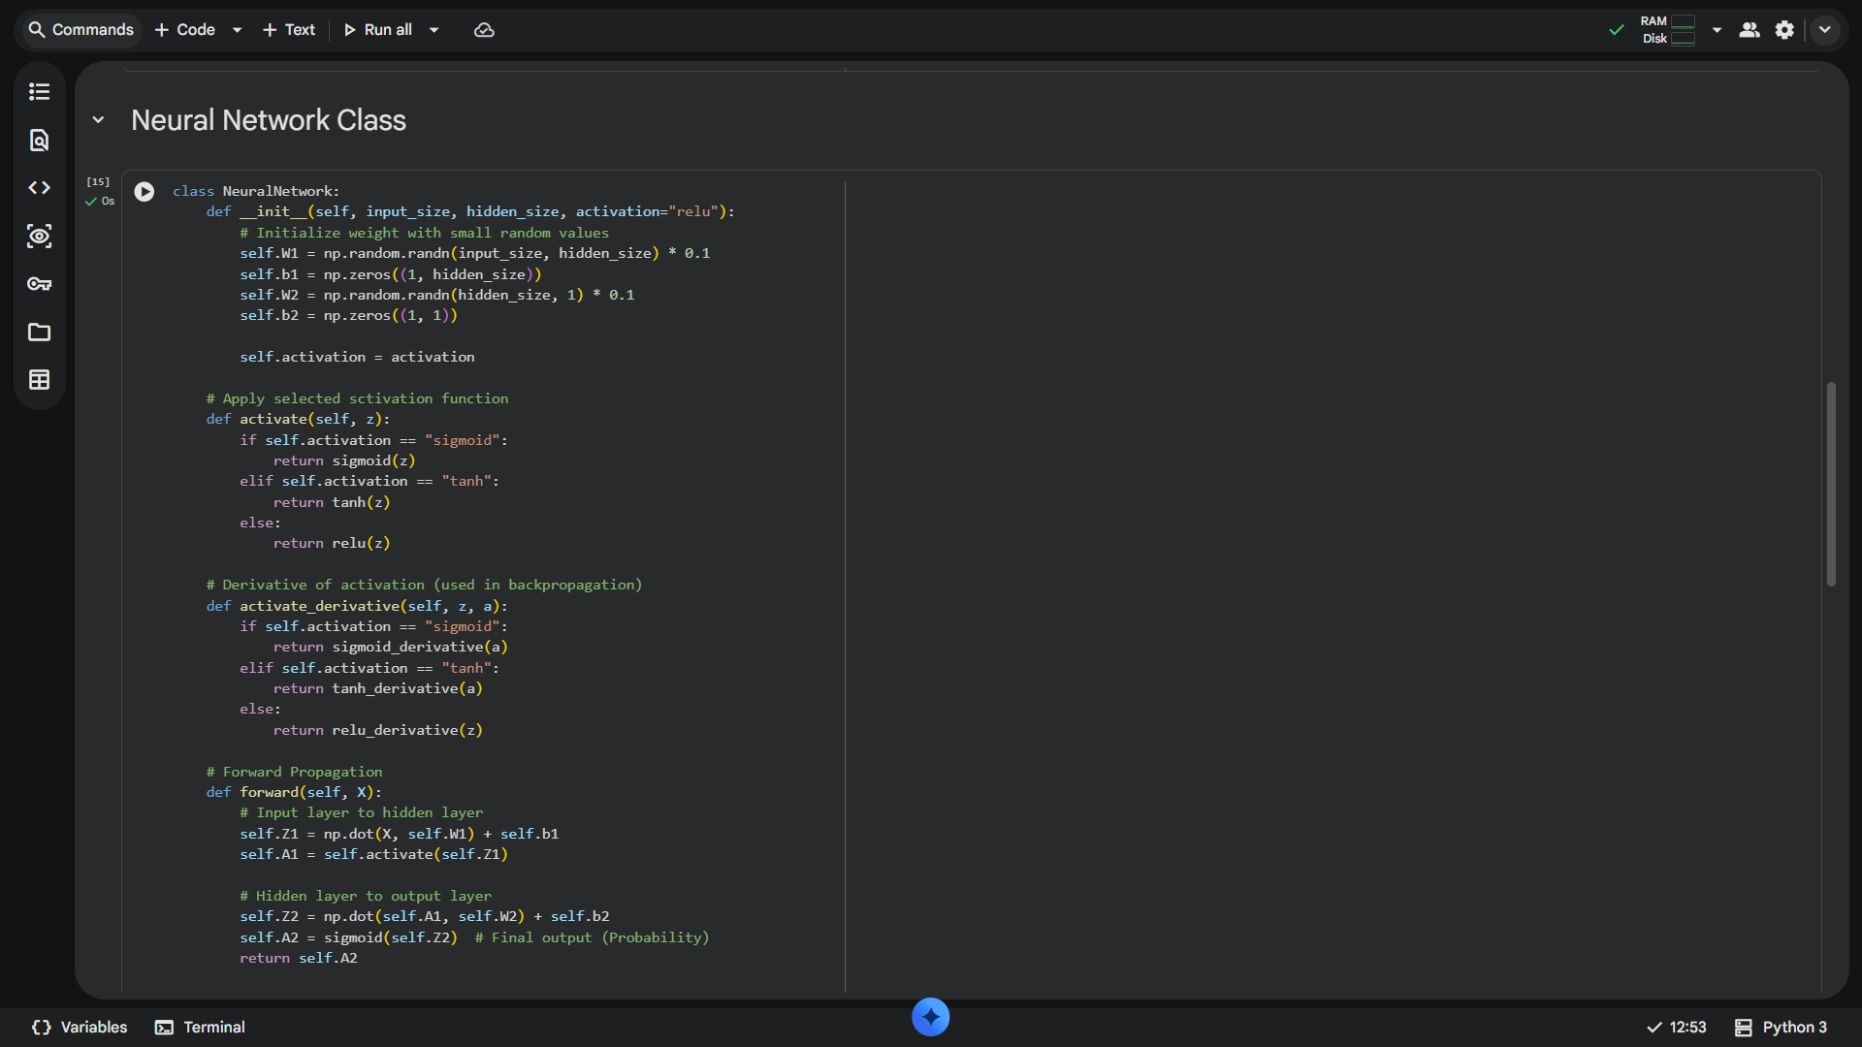

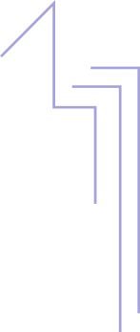

Introduction
This presentation outlines a from-scratch NumPy implementation of a binary neural network, covering *architecture design*, manual backpropagation, and regularization.
It summarizes experiments comparing **activation functions** and hyperparameter tuning results to guide model selection and training strategies.

Slide 3
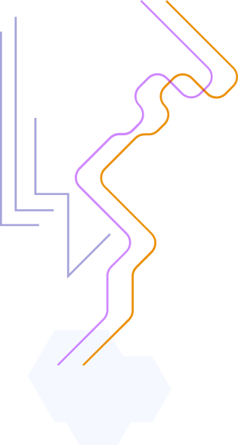
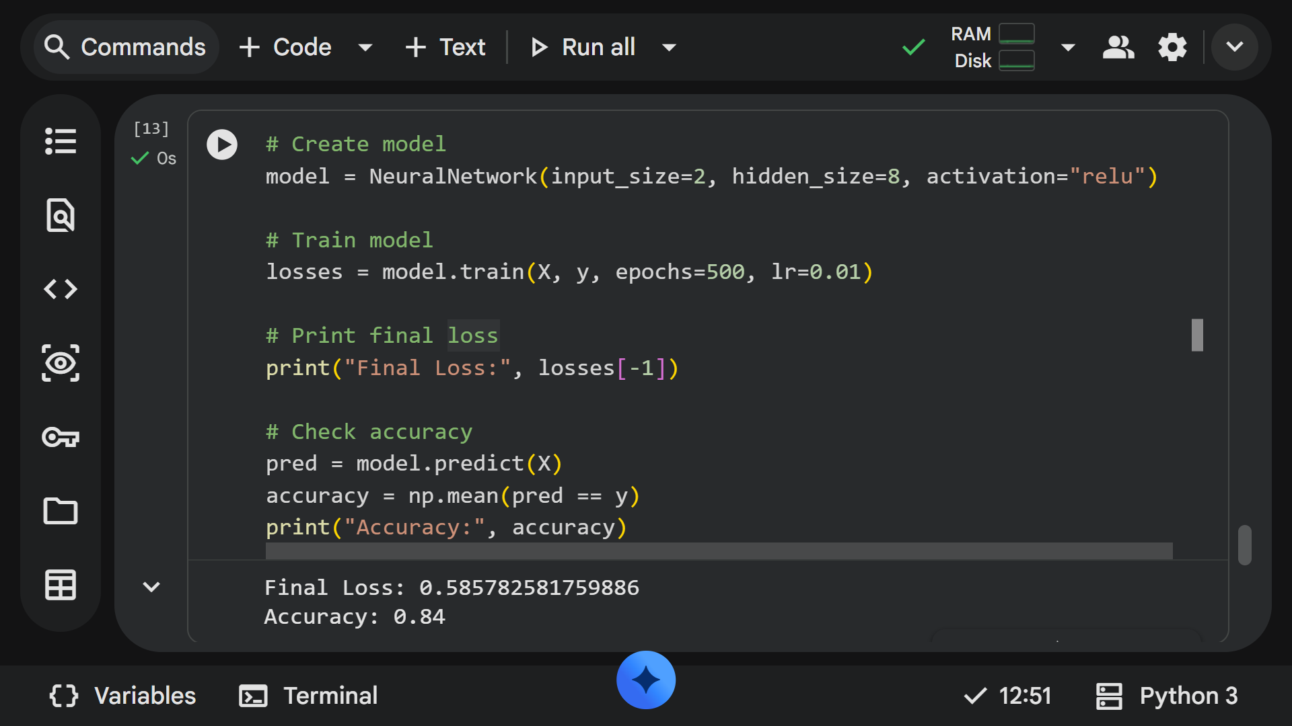
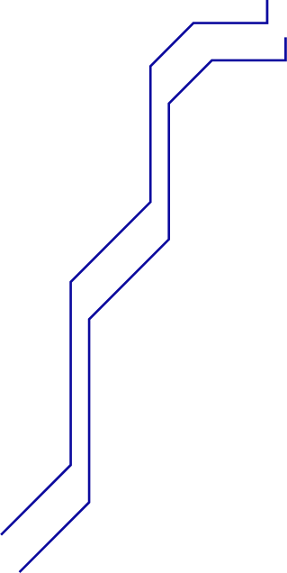
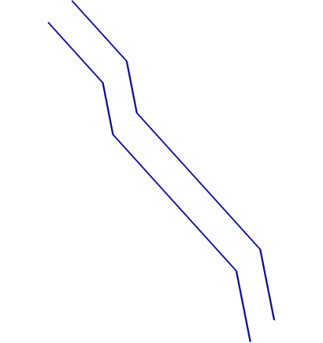
02
Model Implementation

Slide 4
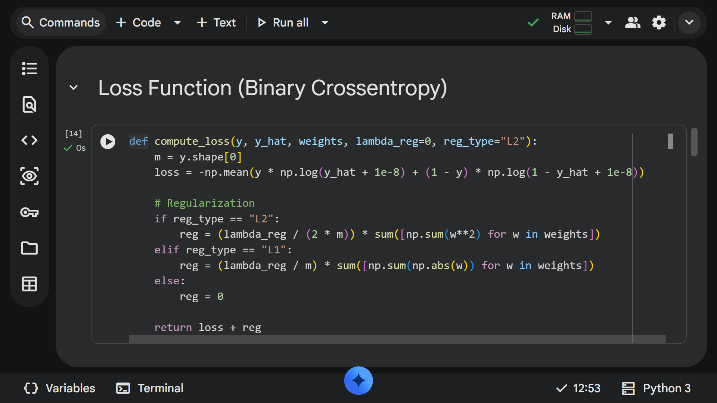
Network Architecture
A compact feedforward network with an input layer, one hidden layer, and a sigmoid output for binary classification. Loss: binary cross-entropy. Training via mini-batch SGD with manual backpropagation and options for L1/L2 regularization.
Design choices include hidden units, initialization, and batch size to balance bias–variance.

Slide 5
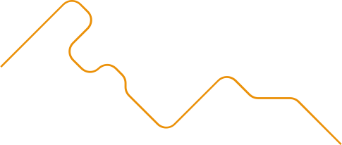




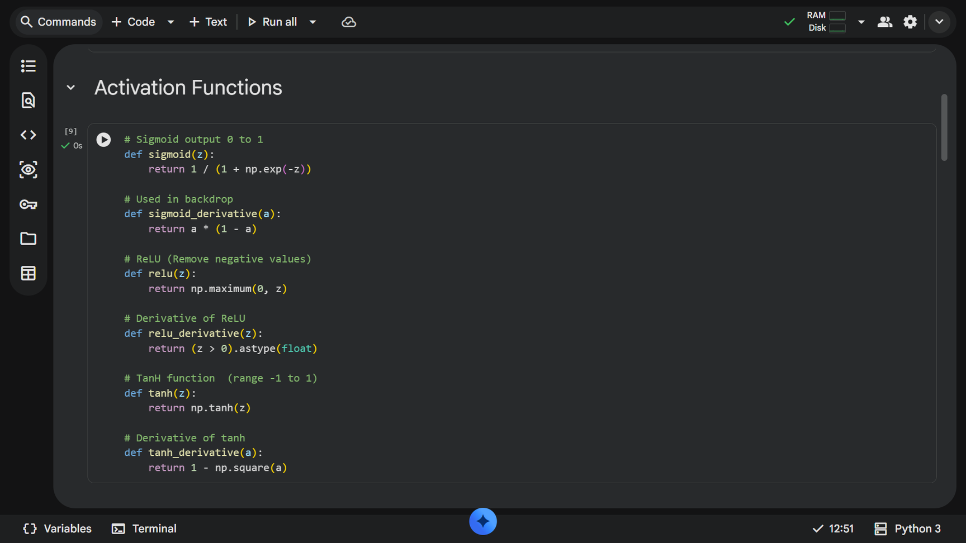
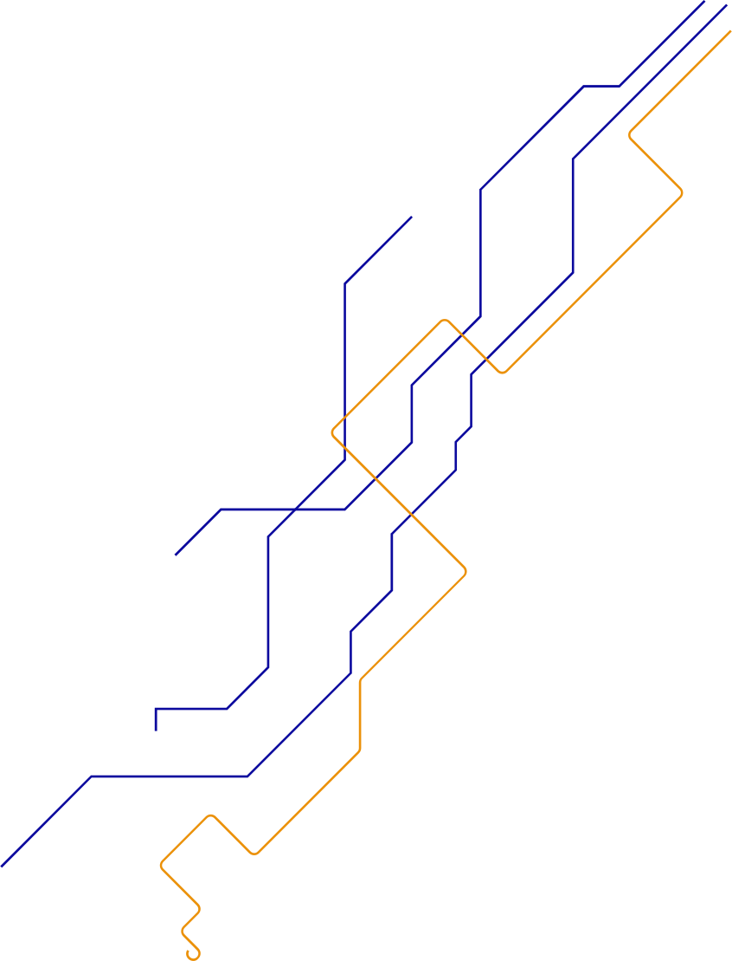
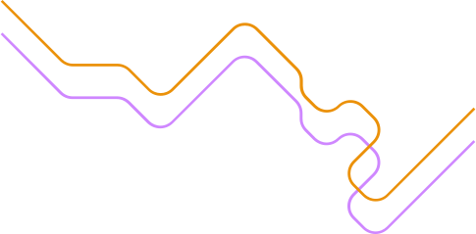
Activation Functions
Compare Sigmoid, ReLU, and Tanh across convergence speed, gradient behavior, and final accuracy. Sigmoid: smooth probabilistic output; can saturate. ReLU: fast convergence, risk of dead neurons. Tanh: zero-centered but still saturates.
Empirical evaluation uses identical settings to isolate activation effects and informs recommended defaults.

Slide 6
Backpropagation & Optimizers
Backpropagation implemented manually using vectorized NumPy operations to compute gradients for weights and biases.
Training uses mini-batch SGD with optional momentum. Gradient updates include L1 and L2 regularization terms applied to weight gradients to control overfitting and sparsity.

Slide 7
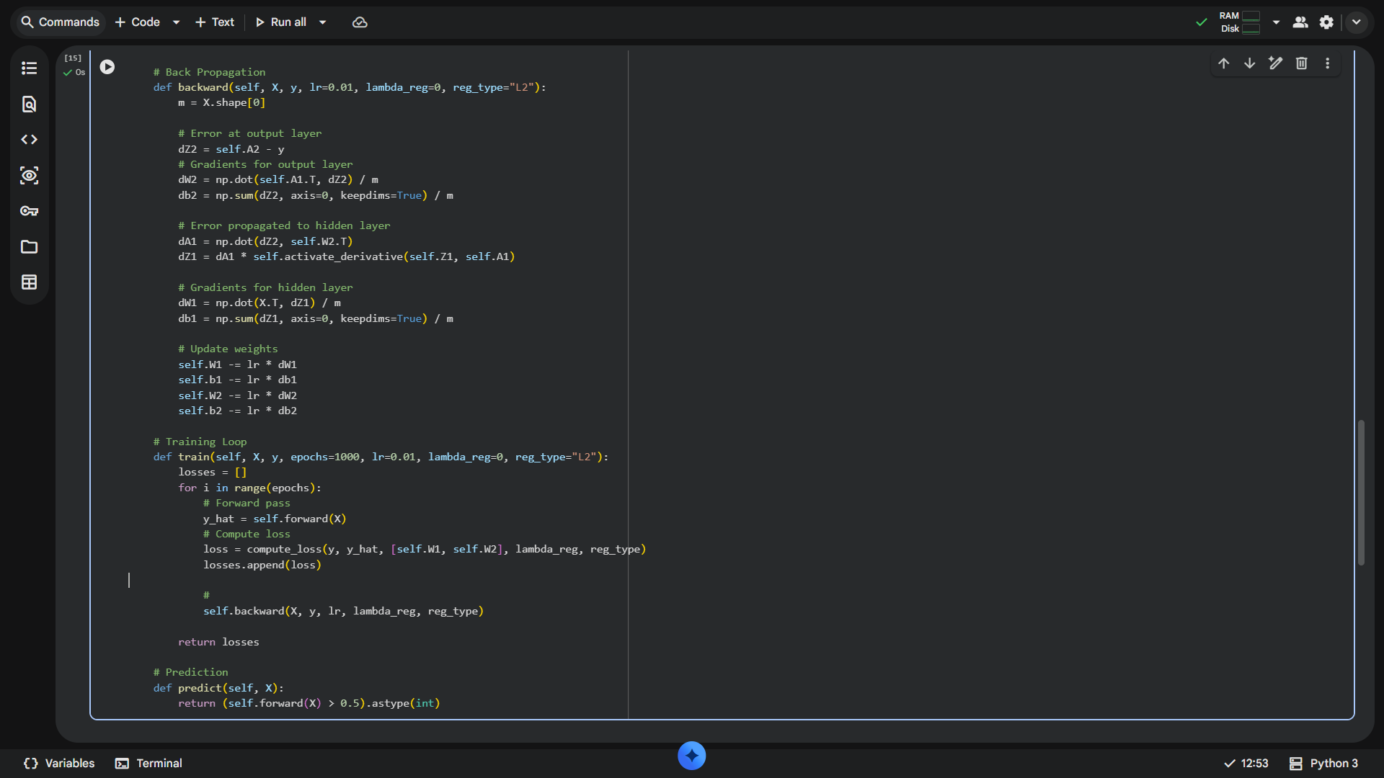
02
Experiments & Results

Slide 8
Regularization Comparison
Evaluated L1 vs L2 on validation loss and sparsity.
L1 promoted weight sparsity and simpler models; L2 produced smaller weights and smoother generalization. Choose L1 for feature selection, L2 for stable convergence.

Slide 9
Hyperparameter Tuning
Systematic grid search over learning rate, epochs, and batch size.
Optimal settings balanced convergence speed and stability: moderate learning rate, sufficient epochs, and mid-sized batches. Use learning rate schedules for further improvement.

Slide 10
Training Analysis & Plots
Key plots: training/validation loss curves, accuracy over epochs, weight distribution histograms, and activation gradients.
Analyze early stopping points, gradient magnitudes to detect vanishing/exploding issues, and per-activation performance to guide architecture tweaks.

Slide 11
Conclusions
Implementation demonstrates a complete NumPy-based binary classifier with manual backpropagation and regularization.
Comparative experiments show activation choice and regularization materially affect performance; hyperparameter tuning is critical. Recommend ReLU for hidden layers and L2 for general use, with targeted tuning per dataset.

Slide 12

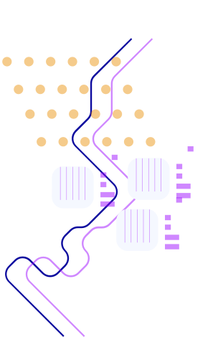


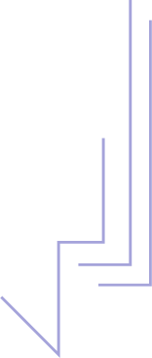






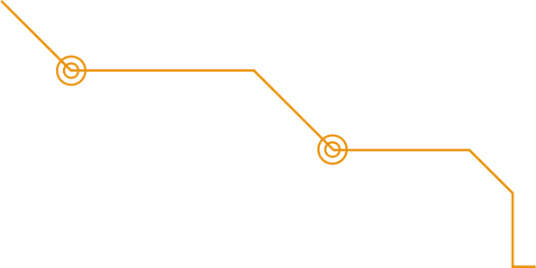

Thanks!
Do you have any questions?
youremail@freepik.com
+34 654 321 432
yourwebsite.com
CREDITS: This presentation template was created by Slidesgo, and includes icons, infographics & images by Freepik

